Slide 1
iGEM bee gut microbiome
IIT-Chicago Team

Slide 2
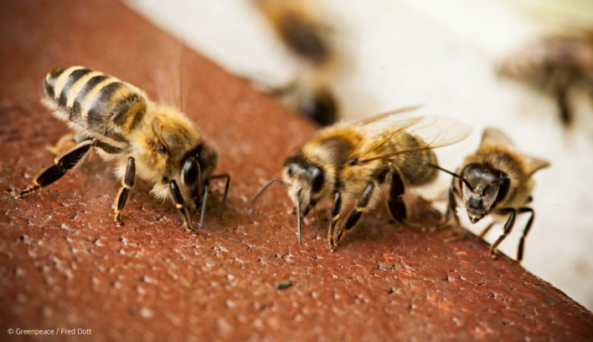
Summary
Values of bees
Bees are the most important pollinators. Pollinators transfer pollen from various crops, facilitating seed formation and fruit production. The economic value of pollinators, including honeybees, in global crop production is estimated to be approximately $235 billion to $577 billion annually. Furthermore, the increasing variety and area of subtropical crops with high pollinator dependence are enhancing the importance of pollinators. For these reasons, honeybees impact 11 out of the 17 United Nations Sustainable Development Goals (SDGs).
Colony Collapse Disorder
A recent phenomenon of mass disappearance of honeybees has been occurring. During the winter of 2021, 7.8 billion honeybees vanished without a trace due to Colony Collapse Disorder (CCD). This scale of damage appears to be continuously growing. Between September and November 2022 alone, 10 billion honeybees disappeared, followed by an estimated 14 billion honeybees disappearing in early 2023. Factors such as climate change and parasitic mites are causing the decline of honeybee populations, severely threatening the beekeeping industry.

Slide 3




Colony Collapse Disorder(CDD)
Pesticides and
Biocides
Loss of
Genetic Diversity
Malnutrition
Pests and
Diseases
Acute and chronic toxicity caused by exposure to herbicides and insecticides.
Lack of genetic variation due to prolonged artificial breeding.
Environmental changes and reliance on monoculture crops as food sources
Threats such as Varroa destructor mites, Tropilaelaps mites, Asian hornets, and viral infections.

Slide 4
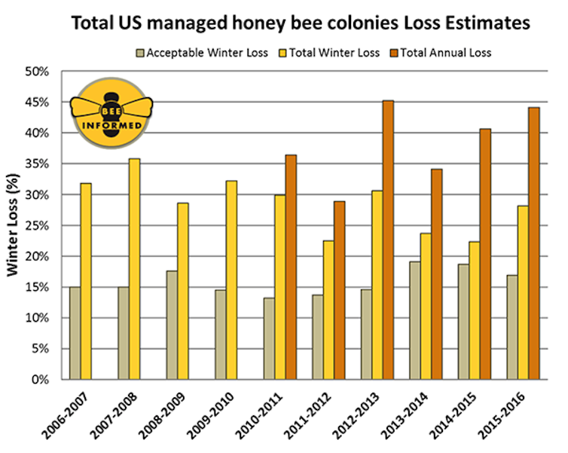
Pesticides
Even after DDT, various pesticides have been developed that pose threats to pollinators.
Organophosphate pesticides are compounds formed by combining phosphorus (P) with oxygen or sulfur. They are highly toxic and work by specifically breaking down acetylcholine, thereby stopping nerve transmission. Although they degrade easily, many of these pesticides are highly toxic to humans and livestock.

Slide 5
Why Target Organophosphates?
OPs Are Still Widely Present
Still heavily used in many countries despite bans in some regions
Residues detected in soil, pollen, wax, and nectar
Bees frequently exposed during foraging
OPs Are Extremely Toxic to Bees
Low LD₅₀ values (e.g., chlorpyrifos: 70 ng/bee)
Act on nervous system → cause rapid paralysis and death
Acute exposure = immediate threat to colony survival
Genetic Tools Are Well-Established​
OP-degrading genes (e.g., opd, opdA, mpd) are​ functionally characterized​ and previously used in microbial expression​
Simplified enzyme pathways

Slide 6



How are we going to fix it?
Our goal is to engineer S. alvi, a key gut microbe in honeybees, by inserting a gene that degrades pesticides, thereby creating pesticide-resistant bees. This is expected to significantly contribute to preventing CCD (Colony Collapse Disorder).

Slide 7
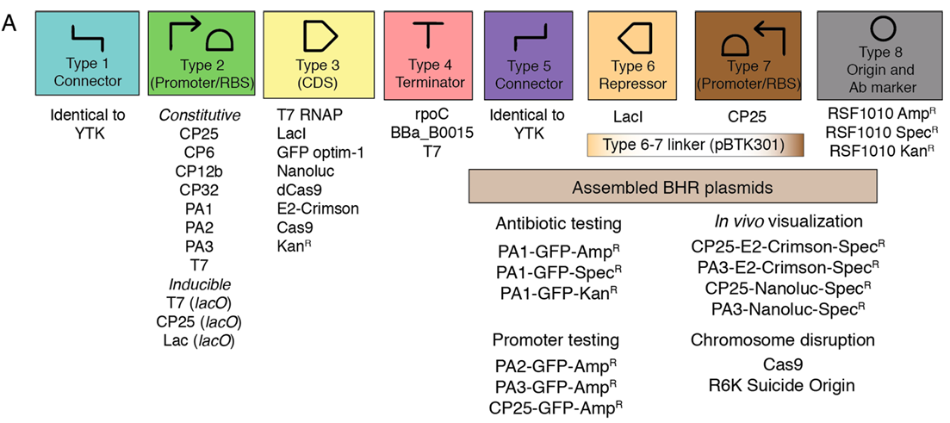
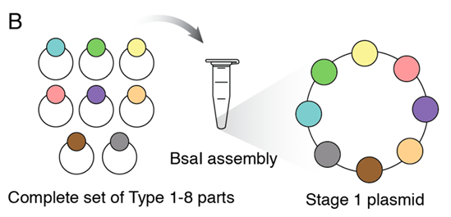
Method
Golden Gate assembly
We plan to use BTK, a genetic modification toolkit designed for S. alvi. BTK utilizes Type II restriction enzymes, which have separate recognition and cleavage sites, to divide the genetic components into types 1 through 8, allowing for convenient assembly using specifically designed overhangs. For example, Type 1 includes various connectors, Type 2 contains promoters and ribosome binding sites, and Type 3 consists of CDS.

Slide 8
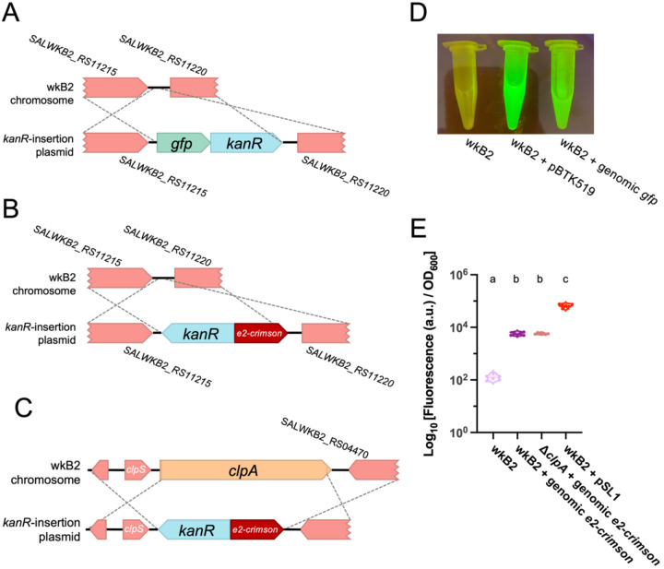
Method
Since plasmids may not be stably maintained in the gut environment of honeybees, we plan to integrate the gene directly into the genome of S. alvi. To achieve this, we will employ homologous recombination using RecA and other recombination proteins. This process requires the plasmid to contain homologous arms on both sides of the target gene. The BTK toolkit provides modules for designing and inserting such homologous arms, allowing us to proceed with genome integration effectively.
Homologous recombination

Slide 9
List of vector assembly part
bp | From | Role
~1000 | pBTK1050 | Homologous arm 1
TBD | TBD | Selector
~100 | pBTK107 | Promotor/RBS
~1000 | synthesize | opd
~100 | synthesize | Terminator
~1000 | pBTK1051 | Homologous arm 2
~2000 | pYTK095 | backbone

Slide 10
Simplified Vector design
Promotor
opd
Terminator
Selector
H1 arm
H2 arm
Backbone

Slide 11
Major Project Milestones
Clone OPH gene into appropriate homologous rec vector
Transfect into S. alvi (electroporate), and screen for recombinants using selectable marker
Demonstrate OPH gene is active in S. alvi
Demonstrate engineered OPH: S alvi can colonize bee gut
Demonstrate activity of OPH in bee gut
Assess differences in pesticide impact on bees with and without OPH: S alvi

